Slide 1
Chapter 11
These slides are designed to accompany Software Engineering: A Practitioner’s Approach, 7/e (McGraw-Hill, 2009) Slides copyright 2009 by Roger Pressman.

Slide 2

Interface Design
Typical Design Errors
lack of consistency
too much memorization
no guidance / help
no context sensitivity
poor response
Arcane/unfriendly
These slides are designed to accompany Software Engineering: A Practitioner’s Approach, 7/e (McGraw-Hill, 2009) Slides copyright 2009 by Roger Pressman.

Slide 3
Golden Rules
Place the user in control
Reduce the user’s memory load
Make the interface consistent
These slides are designed to accompany Software Engineering: A Practitioner’s Approach, 7/e (McGraw-Hill, 2009) Slides copyright 2009 by Roger Pressman.

Slide 4
Place the User in Control
Define interaction modes in a way that does not force a user into unnecessary or undesired actions.
Provide for flexible interaction.
Allow user interaction to be interruptible and undoable.
Streamline interaction as skill levels advance and allow the interaction to be customized.
Hide technical internals from the casual user.
Design for direct interaction with objects that appear on the screen.
These slides are designed to accompany Software Engineering: A Practitioner’s Approach, 7/e (McGraw-Hill, 2009) Slides copyright 2009 by Roger Pressman.

Slide 5
Reduce the User’s Memory Load
Reduce demand on short-term memory.
Establish meaningful defaults.
Define shortcuts that are intuitive.
The visual layout of the interface should be based on a real world metaphor.
Disclose information in a progressive fashion.
These slides are designed to accompany Software Engineering: A Practitioner’s Approach, 7/e (McGraw-Hill, 2009) Slides copyright 2009 by Roger Pressman.

Slide 6
Make the Interface Consistent
Allow the user to put the current task into a meaningful context.
Maintain consistency across a family of applications.
If past interactive models have created user expectations, do not make changes unless there is a compelling reason to do so.
These slides are designed to accompany Software Engineering: A Practitioner’s Approach, 7/e (McGraw-Hill, 2009) Slides copyright 2009 by Roger Pressman.

Slide 7
WebApp Interface Design
Where am I? The interface should
  provide an indication of the WebApp that has been accessed
  inform the user of her location in the content hierarchy.
What can I do now? The interface should always help the user understand his current options
  what functions are available?
  what links are live?
  what content is relevant?
Where have I been, where am I going? The interface must facilitate navigation.
  Provide a “map” (implemented in a way that is easy to understand) of where the user has been and what paths may be taken to move elsewhere within the WebApp.
These slides are designed to accompany Software Engineering: A Practitioner’s Approach, 7/e (McGraw-Hill, 2009) Slides copyright 2009 by Roger Pressman.

Slide 8
Effective WebApp Interfaces
Bruce Tognozzi [TOG01] suggests…
  Effective interfaces are visually apparent and forgiving, instilling in their users a sense of control. Users quickly see the breadth of their options, grasp how to achieve their goals, and do their work.
  Effective interfaces do not concern the user with the inner workings of the system. Work is carefully and continuously saved, with full option for the user to undo any activity at any time.
  Effective applications and services perform a maximum of work, while requiring a minimum of information from users.
These slides are designed to accompany Software Engineering: A Practitioner’s Approach, 7/e (McGraw-Hill, 2009) Slides copyright 2009 by Roger Pressman.

Slide 9
Interface Design Principles-I
Anticipation—A WebApp should be designed so that it anticipates the use’s next move.
Communication—The interface should communicate the status of any activity initiated by the user
Consistency—The use of navigation controls, menus, icons, and aesthetics (e.g., color, shape, layout)
Controlled autonomy—The interface should facilitate user movement throughout the WebApp, but it should do so in a manner that enforces navigation conventions that have been established for the application.
Efficiency—The design of the WebApp and its interface should optimize the user’s work efficiency, not the efficiency of the Web engineer who designs and builds it or the client-server environment that executes it.
These slides are designed to accompany Software Engineering: A Practitioner’s Approach, 7/e (McGraw-Hill, 2009) Slides copyright 2009 by Roger Pressman.

Slide 10
Interface Design Principles-II
Focus—The WebApp interface (and the content it presents) should stay focused on the user task(s) at hand.
Fitt’s Law—“The time to acquire a target is a function of the distance to and size of the target.”
Human interface objects—A vast library of reusable human interface objects has been developed for WebApps.
Latency reduction—The WebApp should use multi-tasking in a way that lets the user proceed with work as if the operation has been completed.
Learnability— A WebApp interface should be designed to minimize learning time, and once learned, to minimize relearning required when the WebApp is revisited.
These slides are designed to accompany Software Engineering: A Practitioner’s Approach, 7/e (McGraw-Hill, 2009) Slides copyright 2009 by Roger Pressman.

Slide 11
Interface Design Principles-III
Maintain work product integrity—A work product (e.g., a form completed by the user, a user specified list) must be automatically saved so that it will not be lost if an error occurs.
Readability—All information presented through the interface should be readable by young and old.
Track state—When appropriate, the state of the user interaction should be tracked and stored so that a user can logoff and return later to pick up where she left off.
Visible navigation—A well-designed WebApp interface provides “the illusion that users are in the same place, with the work brought to them.”
These slides are designed to accompany Software Engineering: A Practitioner’s Approach, 7/e (McGraw-Hill, 2009) Slides copyright 2009 by Roger Pressman.

Slide 12
Interface Design Workflow-I
Review information contained in the analysis model and refine as required.
Develop a rough sketch of the WebApp interface layout.
Map user objectives into specific interface actions.
Define a set of user tasks that are associated with each action.
Storyboard screen images for each interface action.
Refine interface layout and storyboards using input from aesthetic design.
These slides are designed to accompany Software Engineering: A Practitioner’s Approach, 7/e (McGraw-Hill, 2009) Slides copyright 2009 by Roger Pressman.

Slide 13
Interface Design Workflow-II
Identify user interface objects that are required to implement the interface.
Develop a procedural representation of the user’s interaction with the interface.
Develop a behavioral representation of the interface.
Describe the interface layout for each state.
Refine and review the interface design model.
These slides are designed to accompany Software Engineering: A Practitioner’s Approach, 7/e (McGraw-Hill, 2009) Slides copyright 2009 by Roger Pressman.

Slide 14
Aesthetic Design
Don’t be afraid of white space.
Emphasize content.
Organize layout elements from top-left to bottom right.
Group navigation, content, and function geographically within the page.
Don’t extend your real estate with the scrolling bar.
Consider resolution and browser window size when designing layout.
These slides are designed to accompany Software Engineering: A Practitioner’s Approach, 7/e (McGraw-Hill, 2009) Slides copyright 2009 by Roger Pressman.

Slide 15
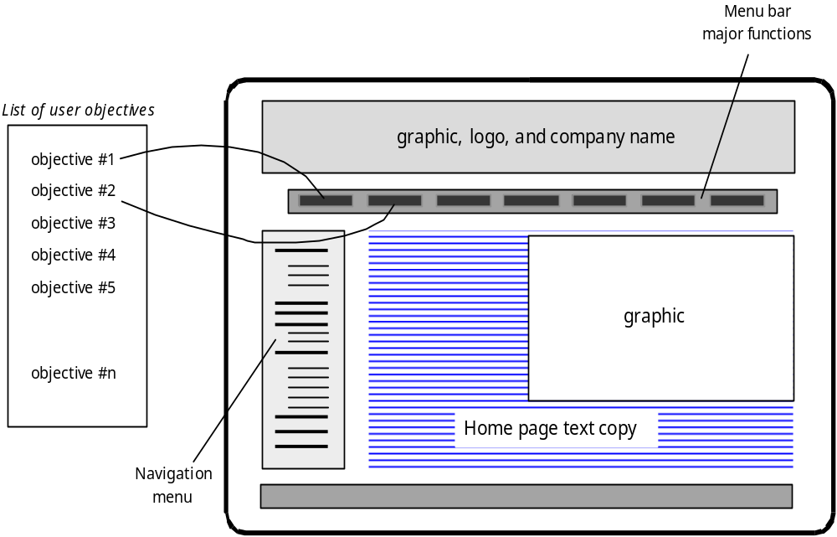
Mapping User Objectives
These slides are designed to accompany Software Engineering: A Practitioner’s Approach, 7/e (McGraw-Hill, 2009) Slides copyright 2009 by Roger Pressman.

Slide 16
Questions
Explain In brief User interface Golden Rules
Explain “Place the user in control” in detail
Explain “Reduce the user’s memory load” in detail
Explain “Make the interface consistent” in detail
Explain any five “Interface Design Principles”
Explain Interface Design Workflow
Explain “ Aesthetic Design” concept.
These slides are designed to accompany Software Engineering: A Practitioner’s Approach, 7/e (McGraw-Hill, 2009) Slides copyright 2009 by Roger Pressman.

